Slide 1
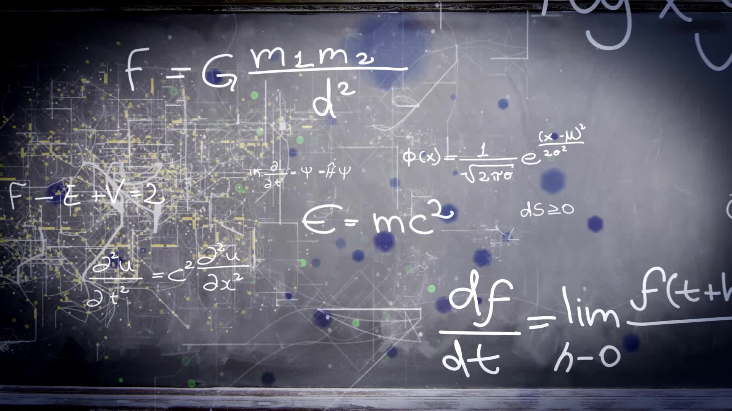
Chapter 3.1:
Extrema On An Interval
HONORS CALCULUS/CALCULUS

Slide 2
Definition of Extrema
$f\left(c\right) is the minimum of f on I if f\left(c\right)≤f\left(x\right) ∀ x in I.$
$f\left(c\right)is the maximum of f on I if f\left(c\right)≥f\left(x\right) ∀ x in I.$
If f is continuous on a closed interval [a, b], then f has both a minimum and a maximum on the interval.
If f is defined at c, then c is called a CRITICAL NUMBER of f if and $f^{′}\left(c\right)=0$ or if $f^{′}\left(c\right)is undefined at c.$
RELATIVE EXTREMA occur only at CRITICAL NUMBERS.
If f has a relative min or a relative max at $x=c$, then c is a critical number of f.

Slide 3
Finding Extrema On A Closed Interval
To find the extrema of a continuous function f on a Closed Interval [a, b], use the following steps:
Find the critical numbers of f in (a, b)
Evaluate f at each critical number in (a, b)
Evaluate f at each endpoint of [a, b]
The Least of These Values is the Minimum/The Greatest is the Maximum

Slide 4
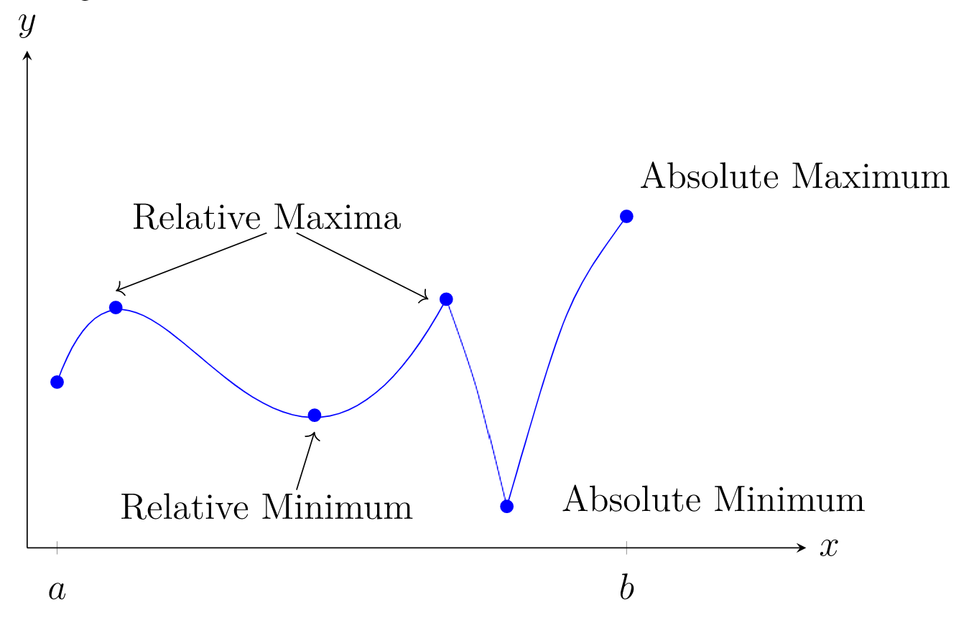
Relative and Absolute Extrema

Slide 5
Ex. 1) Find the Absolute Extrema of $f\left(x\right)=3x^{4}−4x^{3}$ on the interval $[−1,2]$.

Slide 6
Ex. 2) Find the Absolute Extrema of $f\left(x\right)=2x−3x^{2/3}$ on the interval $[−1,3]$.

Slide 7
Ex. 3) Find the Absolute Extrema of $f\left(x\right)=2sinx−cos2x$ on the interval $[0,2π]$.

